Slide 1
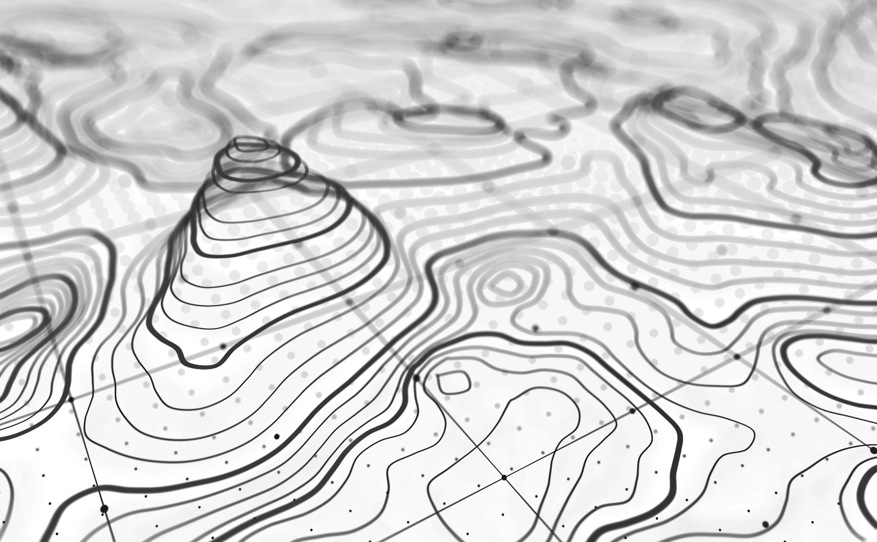

SURVEY, GEOMATICS & 3D MEASURED EXPERTS

Slide 2
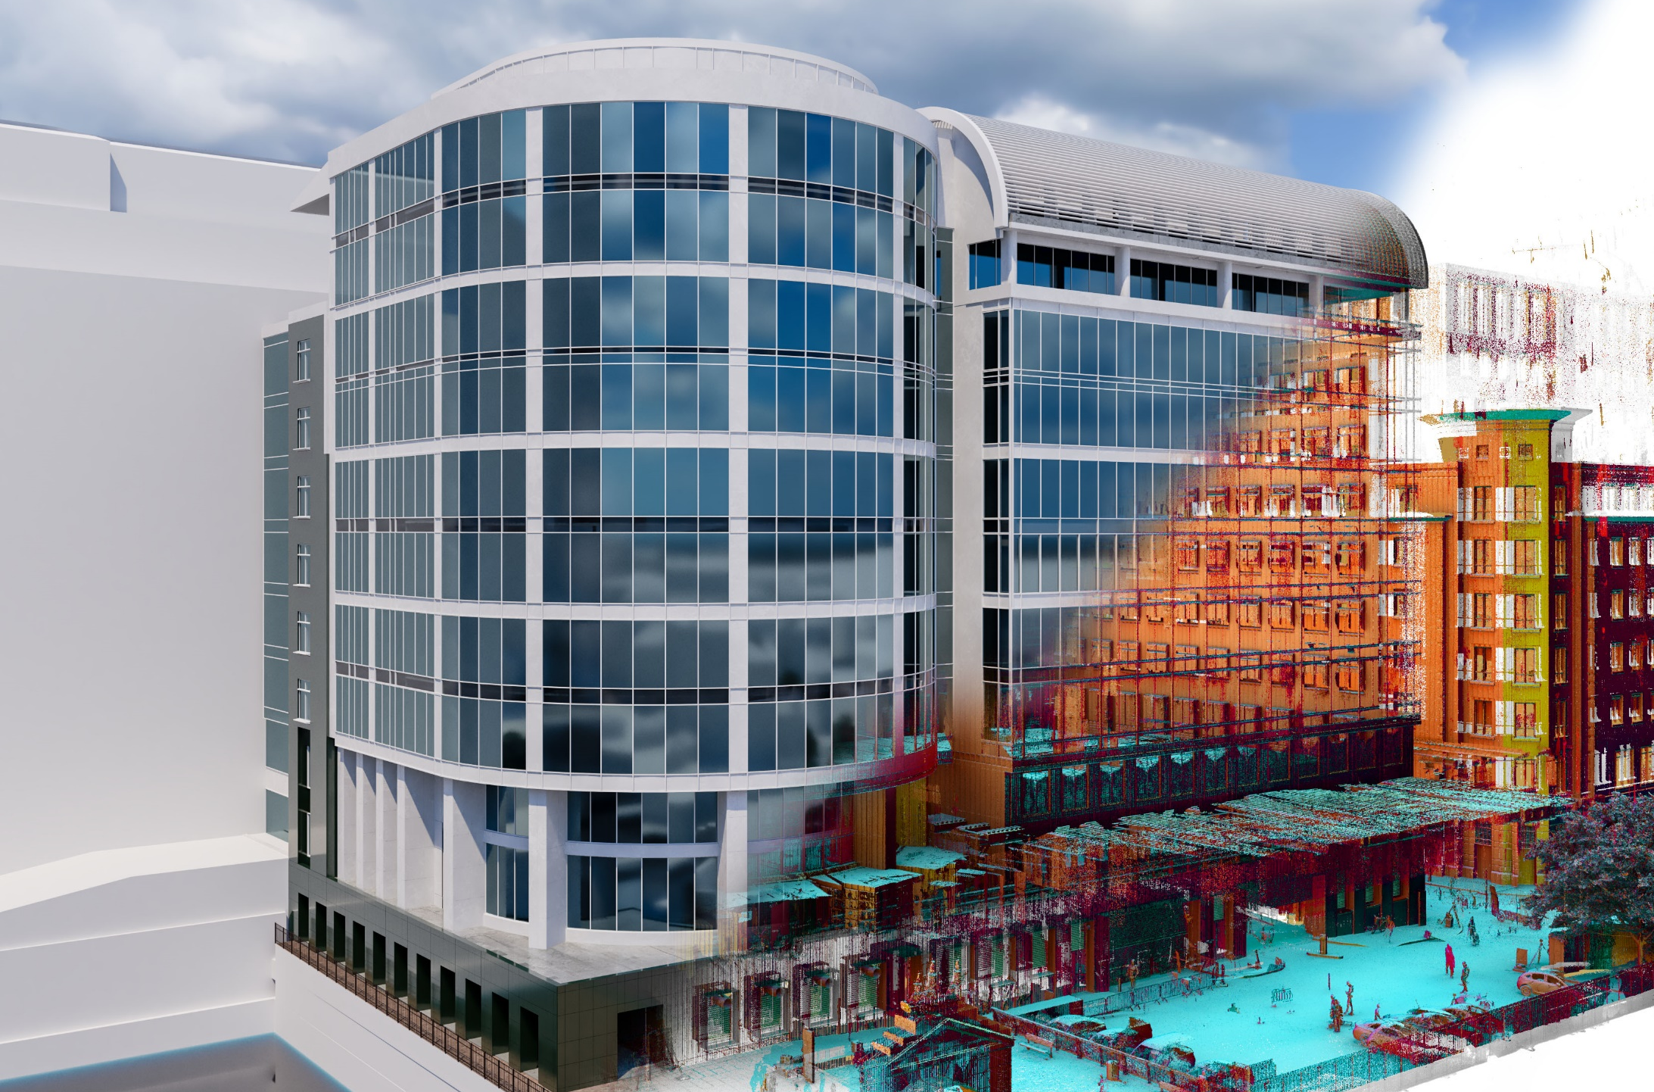
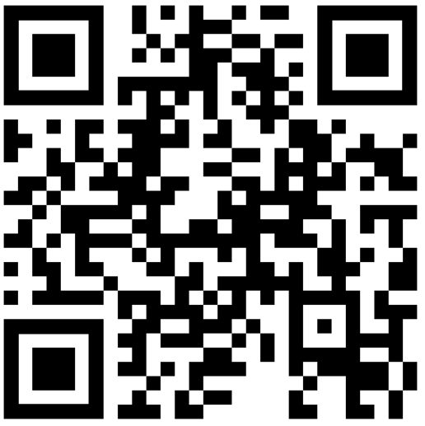











Midlands: 01530 569338
London: 020 3728 2884
Manchester: 0161 549 0206
Southwest: 01242 384677
Scotland: 01312 977961
Survey, Geomatic & 3D Measured Experts
Alex Kowalczuk
Castle Surveys Ltd
Business Development Manager
M: 07595 321931
E: a.kowalczuk@castlesurveys.co.uk
Using:
Visit my website

